Slide 1

Planning and conducting psychological research
Year 12 atar

Slide 2
Goals of Psychological Research
Description – defining, differentiating, recording, describing relationships
Understanding – hypotheses, determining causation
Prediction
Control – influence (e.g. advertising)

Slide 3
Establishing causation
Cause of the phenomenon is consistently related to the effect
Cause must come before the effect
No other plausible alternative explanation for the effect

Slide 4
Influence of experimenter expectations
Treating experimental and control groups differently
Giving non-verbal feedback e.g. smile or grimace to right or wrong answers
Giving verbal feedback to correct responses e.g. ‘okay’, ‘good’ (sometimes inadvertently)

Slide 5
Reducing bias
Double-blind procedure
Physical and emotional distance from the study
Scripts for the experimenter
Minimise experimenter role or minimise contact

Slide 6
Safeguarding rights
Privacy – right of protection from unwanted intrusion by government or other people into one’s affairs
Anonymity – protection of identity when you do not disclose your name
Confidentiality – degree of secrecy of information disclosed in a relationship

Slide 7
Informed consent
Q: What is the protocol with young children?
A: even if parents consent, children still need to have the procedures explained to them clearly and need to assent themselves

Slide 8
Informed consent
Q: What is the age for consent to participate in research and to receive professional counselling?
A: 18

Slide 9
Opinions
Should capacity to give consent be linked to age?
Do you think you are mature enough to make up your own mind?
What are your rights?
What are the rights of your parents or guardians?

Slide 10
Checklist for informed consent
Explain nature and purpose
Clarify foreseeable risks and possible disadvantages
Explain how much info is collected and recorded
Explain how, where, when and for how long info will be stored – and who has access
Advising participants they may or may not participate, and withdraw
Reinforcing nothing will happen if they refuse
Clarify duration of research
Explain confidentiality and limits of confidentiality
Notify conditions under which research may be terminated
Other relevant info

Slide 11
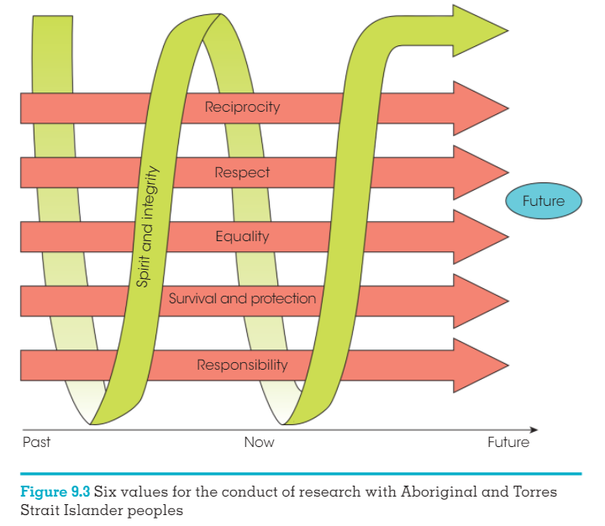
Values for research with Aboriginal and Torres Strait Islander people
National health and medical research council (NHMRC)
-also make considerations for certain other groups e.g. preganant, disabled or involved in illegal activities

Slide 12
Australian Psychological Society code of ethics
After research is published, the data must be made publicly available to other professionals, provided that:
Data is deidentified
Only used for purpose originally stated in research proposal

Slide 13
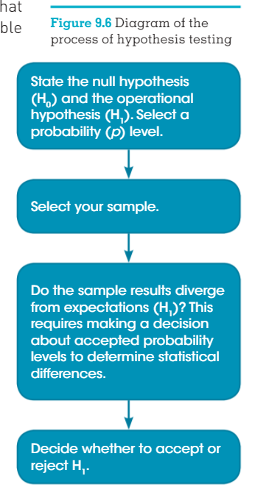
Null Hypothesis
Predicts there will be no change in the DV by manipulation of the IV

Slide 14
Other terminology
Uncontrolled variable – allowed to stay random as it would not affect the results e.g. eye colour
Repeated measures design – the same group of people are both the control and experimental groups (before and after)
Cohort – a group of people of the same age who have experienced the same cultural conditions and environmental effects

Slide 15
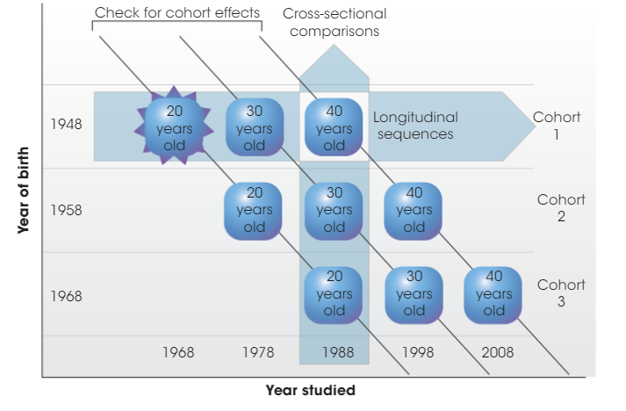
Longitudinal – sequential design

Slide 16
Reasons to use non-experimental (descriptive) research methods
Variables not possible to be modified (e.g. gender, age)
Can’t modify variables due to ethical reasons (e.g. smoking or alcohol)
Not feasible to alter variables (e.g. at school)

Slide 17
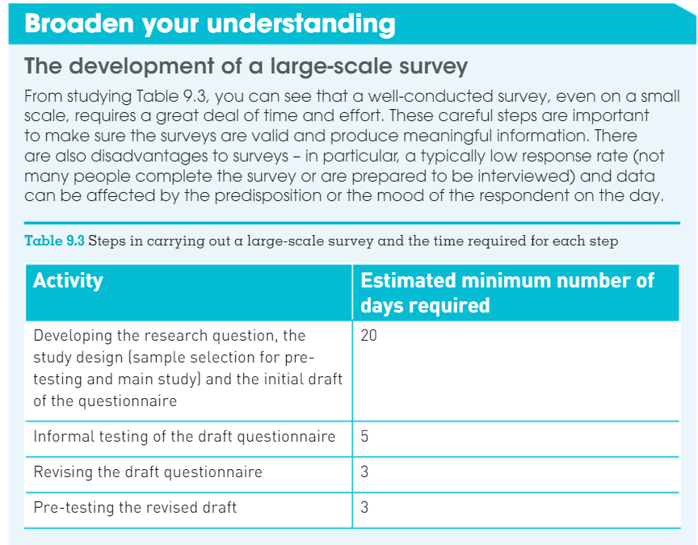

Slide 18
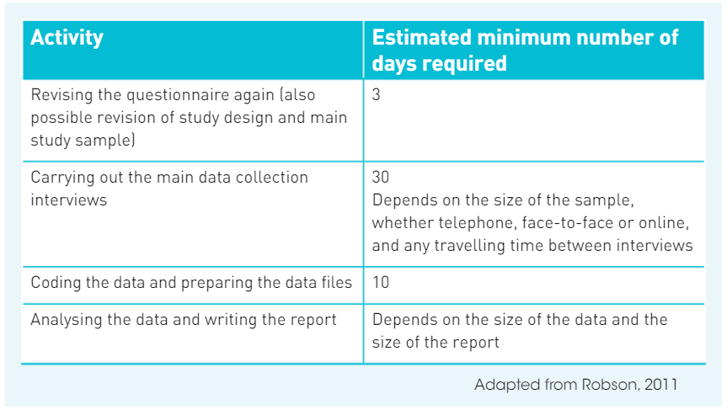

Slide 19
Archives - types
Statistical (e.g. census data)
Written and electronic (e.g. PM speeches)
Responses to national surveys

Slide 20
Behavioural Variables
Pre-exist and can not be varied as an IV
e.g. amount of lead used in a pencil over a certain time writing – behavioural variable would be the pressure applied by the writer

Slide 21
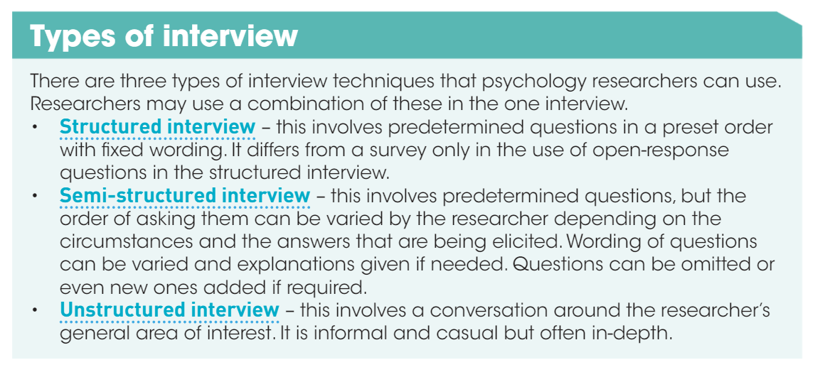

Slide 22
